Slide 1
Surviving an Active Shooter Event
Loss Control Department

Slide 2
DO WE REALLY NEED THIS TRAINING?
Hopefully not! But, it’s best to have a safe plan of action in place.
Notes:
Recent events in Walmart in El Paso, Gilroy, CA Garlic Festival, and entertainment district in Dayton showcase why it is important to think of this ahead of time. None of those victims thought something like this could ever happen to them either. (Examples used here will, unfortunately, likely need to be updated to reflect the most recent shootings).

Slide 3
How Do We Define an Active Shooter?
FBI/DHS definition: An active shooter is someone actively engaged in killing or attempting to kill people in a populated area.
Notes:
Implicit in this definition is that the assailant is using a gun. “Mass shootings” are classified as those with 4 or more victims.

Slide 4
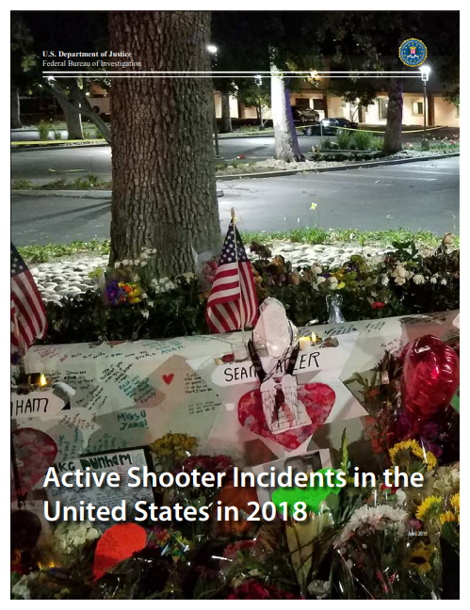
April 2019 FBI Report
Notes:
FBI has numerous studies out on Active Shooters, this is the most recent. . . Statistics from the next few slides come from this report.

Slide 5
In 2018
27 active shooter incidents
213 casualties (excluding the shooters)
85 killed
128 wounded
27 shooters
23 male
3 female
1 unknown
Notes:
Low frequency, high severity incidents.
Primarily male perpetrators.

Slide 6
Notes:
“Commerce” means businesses generally open to the public, Ex., restaurants, grocery stores, malls, etc.
“Business” means places where the public is generally not permitted, Ex. warehouses, offices, etc.

Slide 7
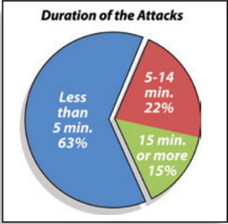
TIME STATISTICS ARE FRIGHTENING
2000 - 2013
2018
Of 160 incidents studied, 107 ended before police arrived, either because a citizen intervened or the shooter fled/committed suicide
Source: “A Study of Active Shooter Incidents in the United States between 2000 and 2013” – fbi.gov
Source: Mass Attacks In Public Spaces, U.S. Secret Service, July 2019
Notes:
27 incidents met the criteria of a mass shooting (4 or more victims) in 2018.

Slide 8
How 2018 Active Shooter Events Ended
10 shooters committed suicide
11 shooters were apprehended
4 shooters were killed by police
1 shooter was killed by citizens
1 shooter remains at large
Notes:
Also workplaces, movie theaters, graduation parties, . . .

Slide 9
Reality Check
Under the best of circumstances police are minutes away.
Until police arrive you (collectively) are the first responder(s).
Your job is to survive until law enforcement arrives.
Notes:
Your job is to survive until law enforcement arrives.

Slide 10
While Still Rare, It Is Imperative To Be Prepared
Fire drills
Tornado drills
Active shooter drills

Slide 11
http://activeshooter.lasd.org/ASdownload.html

Slide 12
You Can’t Afford to Freeze And Do Nothing. Have a Plan. Do Something
Run, Hide, Fight
Escape, Barricade, Fight
Run, Hide, Attack
Run, Conceal, Attack
Notes:
Derivations of same approach

Slide 13
Circumstances May Alter The Order
Fight, Run, Hide,
Barricade, Escape, Fight
Attack, Run, Hide
Run, Conceal, Attack
Notes:
If you’re in close proximity to shooter when he starts shooting, running may not be a good option.
If shooter is blocking only exit, but is not close to you or you’re not in his line of sight yet, hiding or barricading yourself somewhere might be your best first option.
Have to be fluid with choices and willing and able to change course quickly.
When possible coordinate actions with others.

Slide 14
Preplanning saves lives
Identify lockable/hiding areas.
Know where multiple nearby exits are located.
Locate and harden (or lock) unmonitored entry points.
Design and practice a way to immediately communicate a threat to everyone in your building.

Slide 15
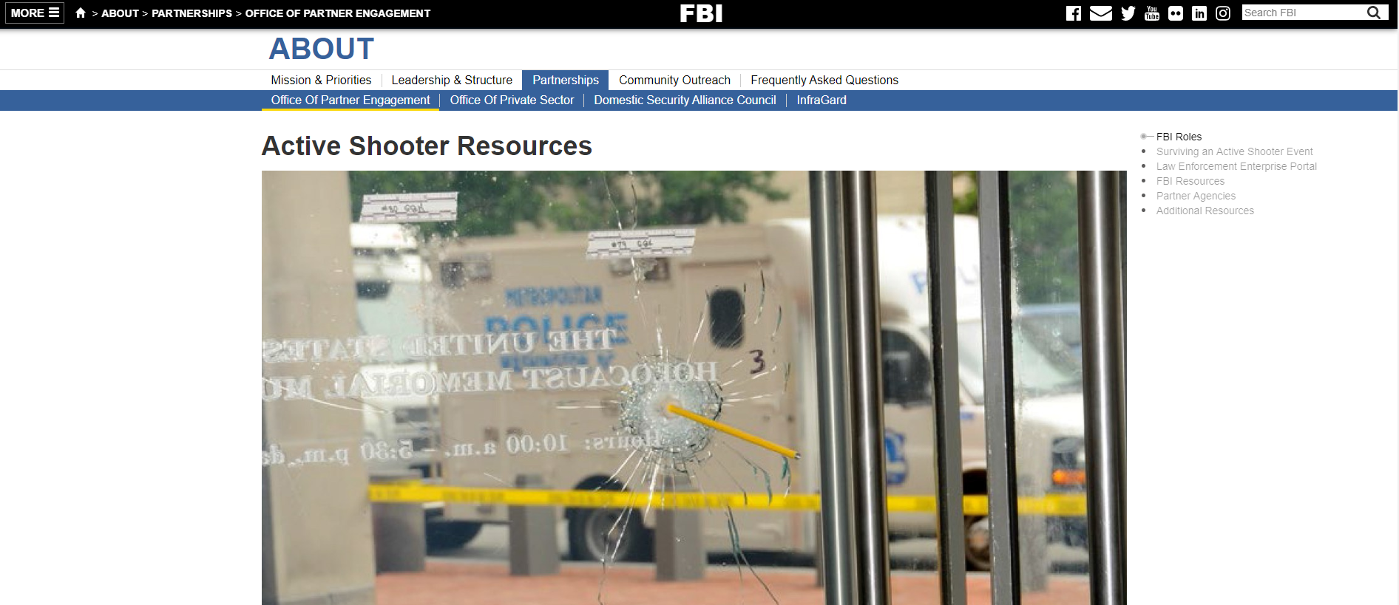
For Additional Information
https://www.fbi.gov/about/partnerships/office-of-partner-engagement/active-shooter-resources
Notes:
FBI resources

Slide 16
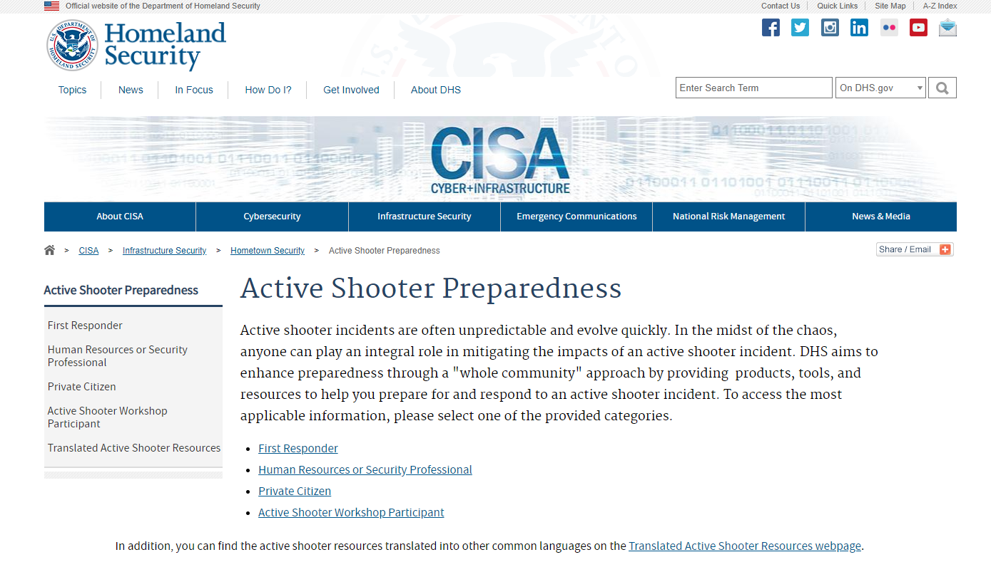
https://www.dhs.gov/cisa/active-shooter-preparedness
Notes:
Homeland Security

Slide 17
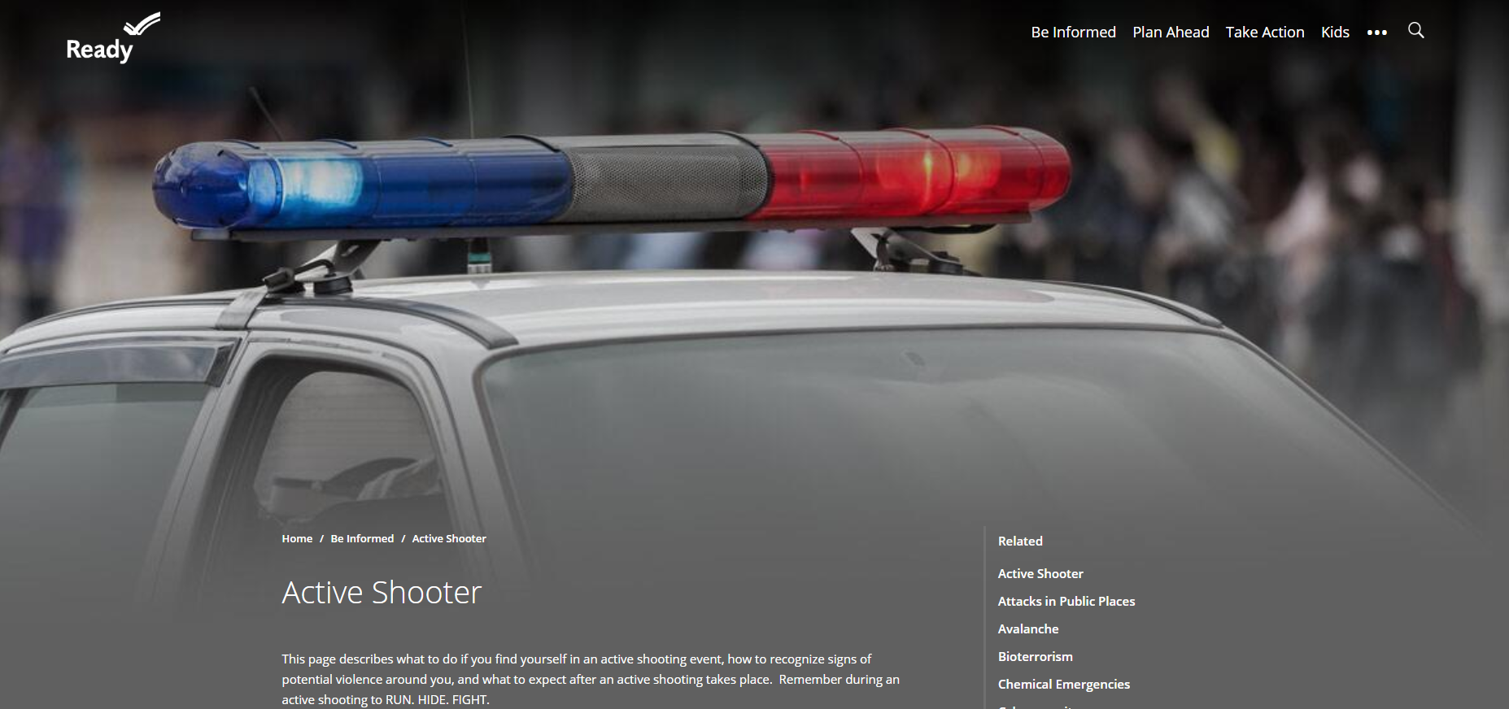
Others
https://www.ready.gov/active-shooter
Local Law Enforcement agencies and websites

Slide 18
Questions/Comments

